Slide 1






Multipath TCP
Olivier Bonaventure
http://inl.info.ucl.ac.be
Thanks to Sébastien Barré, Christoph Paasch, Grégory Detal, Mark Handley, Costin Raiciu, Alan Ford, Micchio Honda, Fabien Duchene and many others
November 2012

Slide 2
Agenda
The motivations for Multipath TCP
The changing Internet
The Multipath TCP Protocol
Multipath TCP use cases

Slide 3
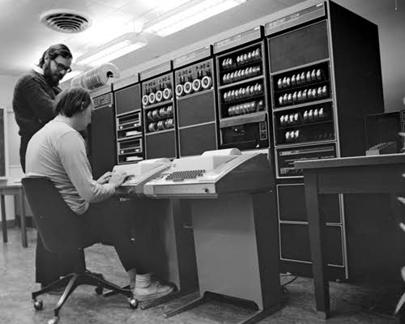
The origins of TCP
Source : http://spectrum.ieee.org/computing/software/the-strange-birth-and-long-life-of-unix
Notes:
Mention coverage, performance, range, etc.

Slide 4
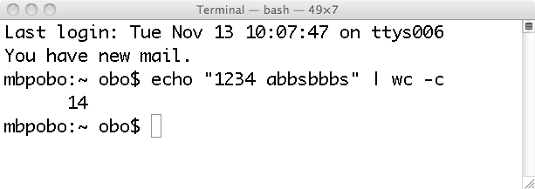
The Unix pipe model
1234 abbsbbbs
echo
wc

Slide 5
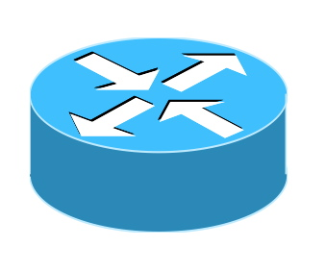

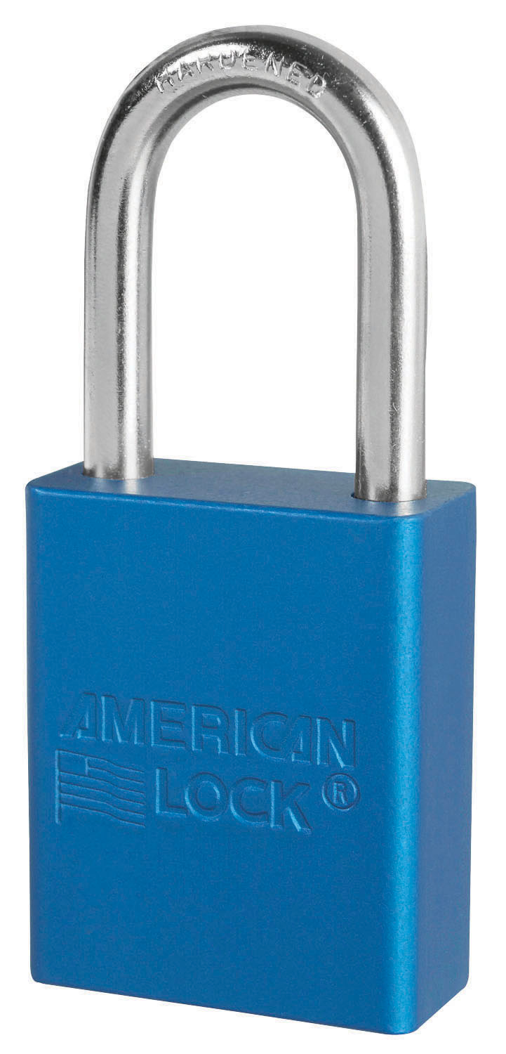
The TCP bytestream model
Client
ABCDEF...111232
Server
0988989 ... XYZZ
IP:1.2.3.4
IP:4.5.6.7

Slide 6
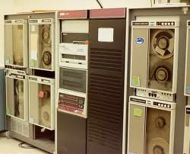

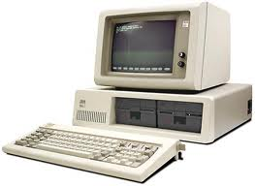
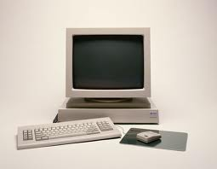
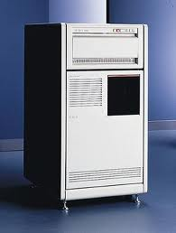

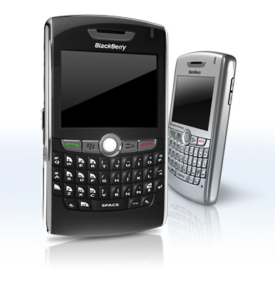
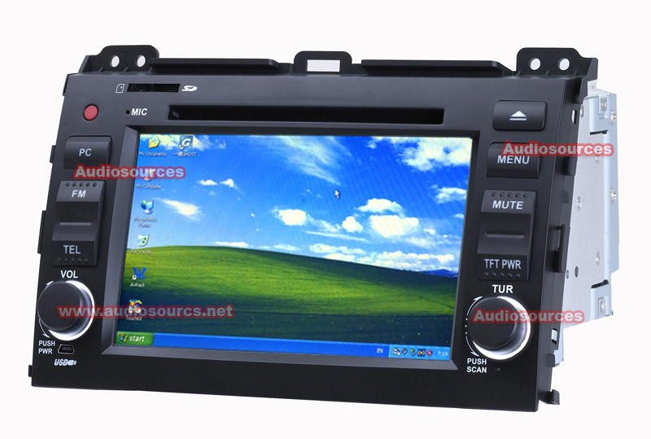
Endhosts have evolved
Mobile devices have multiple wireless interfaces

Slide 7
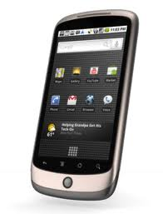
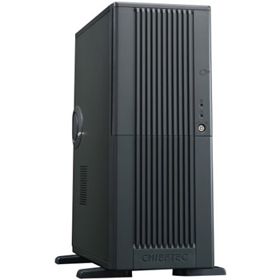
User expectations

Slide 8
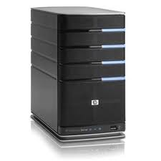
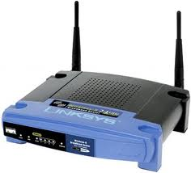
What technology provides
3G celltower
IP 1.2.3.4
Notes:
ajouter adresse ip

Slide 9
What technology provides
3G celltower
IP 1.2.3.4
IP 5.6.7.8

Slide 10
What technology provides
3G celltower
IP 1.2.3.4
IP 5.6.7.8
When IP addresses change TCP connections
have to be re-established !

Slide 11
Equal Cost Multipath
ECMP implementation
Packet arrival :
Hash(IP_{src}, IP_{dst}, Prot, Port_{src}, Port_{dst}) mod #oif
Packets from one TCP connection follow same path
Different connections follow different paths
Notes:
connexion tp versus paquets

Slide 12
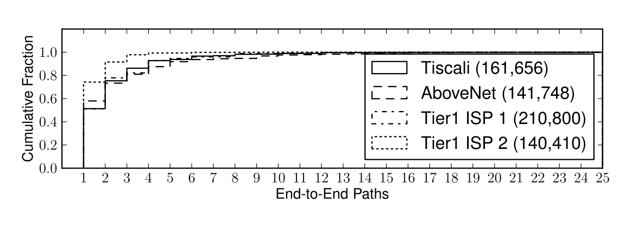
How prevalent is ECMP ?
Analysis of ISP network topologies
G. Detal, Ch. Paasch, S. van der Linden, P. Mérindol, G. Avoine, O. Bonaventure, Revisiting Flow-Based Load Balancing: Stateless Path Selection in Data Center Networks, to appear in Computer Networks

Slide 13

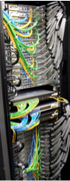
Datacenters
Notes:
Mention coverage, performance, range, etc.

Slide 14
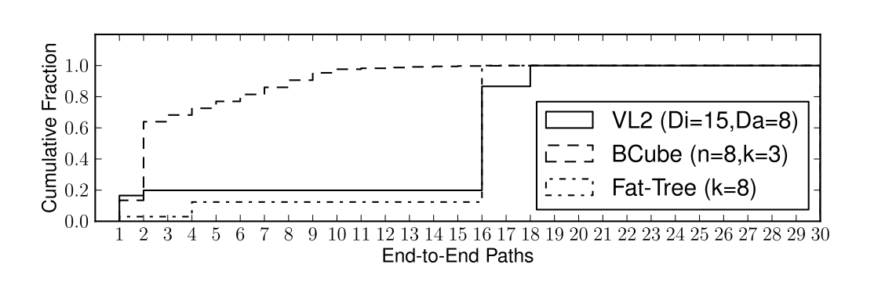
ECMP in datacenters
G. Detal, Ch. Paasch, S. van der Linden, P. Mérindol, G. Avoine, O. Bonaventure, Revisiting Flow-Based Load Balancing: Stateless Path Selection in Data Center Networks, to appear in Computer Networks

Slide 15
IPv4 and IPv6 paths are not always congruent
IP6=2a00:cafe::1
IP=3.4.5.6
IP=3.4.5.6
IP6=2a00:1450:400c:c05::69

Slide 16
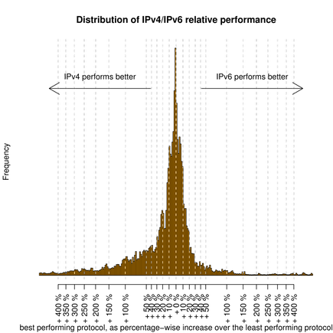
IPv4 and IPv6 performance may differ
E. Aben, Measuring World IPv6 Day - Comparing IPv4 and IPv6 Performance,
https://labs.ripe.net/Members/emileaben/measuring-world-ipv6-day-comparing-ipv4-and-ipv6-performance

Slide 17
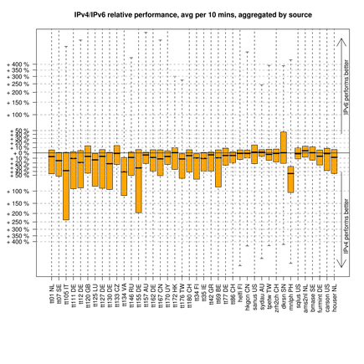
IPv4 versus IPv6 performance
E. Aben, Measuring World IPv6 Day - Comparing IPv4 and IPv6 Performance,
https://labs.ripe.net/Members/emileaben/measuring-world-ipv6-day-comparing-ipv4-and-ipv6-performance

Slide 18
Agenda
The motivations for Multipath TCP
The changing Internet
The Multipath TCP Protocol
Multipath TCP use cases

Slide 19
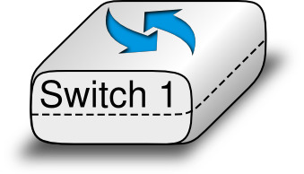
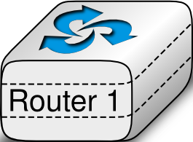

The Internet architecture that we explain to our students
Application
Transport
Datalink
Network
Physical
Datalink
Physical
Network
Datalink
Physical
Physical
O. Bonaventure, Computer networking : Principles, Protocols and Practice, open ebook, http://inl.info.ucl.ac.be/cnp3

Slide 20
A typical "academic" network
Application
Application
Transport
Transport
Network
Network
Network
Datalink
Datalink
Datalink
Datalink
Physical
Physical
Physical
Physical

Slide 21
The end-to-end principle
Application
Application
TCP
Transport
Transport
Network
Network
Network
Datalink
Datalink
Datalink
Datalink
Physical
Physical
Physical
Physical

Slide 22
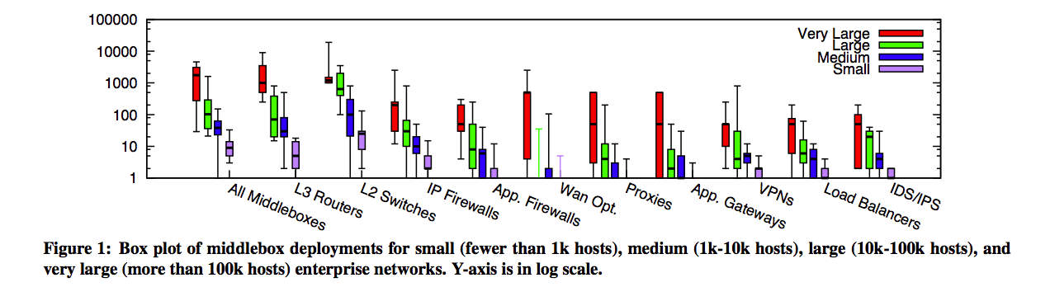
In reality
  almost as many middleboxes as routers
  various types of middleboxes are deployed
Sherry, Justine, et al. "Making middleboxes someone else's problem: Network processing as a cloud service." Proceedings of the ACM SIGCOMM 2012 conference. ACM, 2012.

Slide 23
A middlebox zoo
Web Security Appliance
VPN Concentrator
SSL
Terminator
NAC Appliance
ACE XML
Gateway
PIX Firewall
Right and Left
Cisco IOS Firewall
IP Telephony Router
Voice Gateway
Streamer
NAT
Content Engine
http://www.cisco.com/web/about/ac50/ac47/2.html

Slide 24

How to model those middleboxes ?
In the official architecture, they do not exist
In reality...
Application
Application
Application
TCP
Transport
Transport
Transport
Network
Network
Network
Network
Datalink
Datalink
Datalink
Datalink
Physical
Physical
Physical
Physical

Slide 25
TCP segments processed by a router
Ver IHL ToS
Total length
Ver IHL ToS
Total length
Identification
Flags Frag. Offset
Identification
Flags Frag. Offset
IP
TTL Protocol
Checksum
TTL Protocol
Checksum
Source IP address
Source IP address
Destination IP address
Destination IP address
Source port
Destination port
Source port
Destination port
Sequence number
Sequence number
Acknowledgment number
Acknowledgment number
TCP
THL Reserved Flags
Window
THL Reserved Flags
Window
Checksum
Urgent pointer
Checksum
Urgent pointer
Options
Options
Payload
Payload

Slide 26
TCP segments processed by a NAT
Ver IHL ToS
Total length
Ver IHL ToS
Total length
Identification
Flags Frag. Offset
Identification
Flags Frag. Offset
TTL Protocol
Checksum
TTL Protocol
Checksum
Source IP address
Source IP address
Destination IP address
Destination IP address
Source port
Destination port
Source port
Destination port
Sequence number
Sequence number
Acknowledgment number
Acknowledgment number
THL Reserved Flags
Window
THL Reserved Flags
Window
Checksum
Urgent pointer
Checksum
Urgent pointer
Options
Options
Payload
Payload
Notes:
c

Slide 27
TCP segments processed by a NAT (2)
active mode ftp behind a NAT
220 ProFTPD 1.3.3d Server (BELNET FTPD Server) [193.190.67.15]
ftp_login: user `<null>' pass `<null>' host `ftp.belnet.be'
Name (ftp.belnet.be:obo): anonymous
---> USER anonymous
331 Anonymous login ok, send your complete email address as your password
Password:
---> PASS XXXX
---> PORT 192,168,0,7,195,120
200 PORT command successful
---> LIST
150 Opening ASCII mode data connection for file list
lrw-r--r-- 1 ftp ftp 6 Jun 1 2011 pub -> mirror
226 Transfer complete

Slide 28
TCP segments processed by an ALG running on a NAT
Ver IHL ToS
Total length
Ver IHL ToS
Total length
Identification
Flags Frag. Offset
Identification
Flags Frag. Offset
TTL Protocol
Checksum
TTL Protocol
Checksum
Source IP address
Source IP address
Destination IP address
Destination IP address
Source port
Destination port
Source port
Destination port
Sequence number
Sequence number
Acknowledgment number
Acknowledgment number
THL Reserved Flags
Window
THL Reserved Flags
Window
Checksum
Urgent pointer
Checksum
Urgent pointer
Options
Options
Payload
Payload

Slide 29
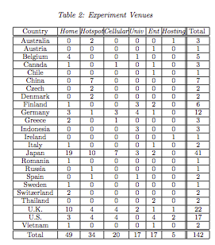
How transparent is the Internet ?
25th September 2010 to 30th April 2011
142 access networks
24 countries
Sent specific TCP segments from client to a server in Japan
Honda, Michio, et al. "Is it still possible to extend TCP?" Proceedings of the 2011 ACM SIGCOMM conference on Internet measurement conference. ACM, 2011.
© O. Bonaventure, 2011

Slide 30
How to extend TCP ?
RFC1323
Large window extension
  supports >64KBytes windows by shifting window field in TCP segment header
SYN+WScale=10
SYN+WScale=10
Snd.Wind.Scale=10
Rcv.Wind.Scale=?
Snd.Wind.Scale=4
4
SYN+ACK
WScale=4
SYN+ACK
WScale=4
Rcv.Wind.Scale=
10
Notes:
peut-être supprimer la partie rfc1323

Slide 31
How to extend TCP ?
RFC1323
What happens with middleboxes ?
SYN+WScale=10
SYN
Snd.Wind.Scale=10
0
Rcv.Wind.Scale=?
Snd.Wind.Scale=
0
0
SYN+ACK
SYN+ACK
Rcv.Wind.Scale=
0

Slide 32
How to extend TCP ?
RFC1323
What happens with middleboxes ?
SYN+WScale=10
SYN+WScale=10
Snd.Wind.Scale=10
0
Rcv.Wind.Scale=?
0
Snd.Wind.Scale=
4
?
SYN+ACK
WScale=4
SYN+ACK
Rcv.Wind.Scale=
10

Slide 33
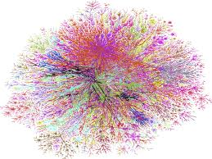
End-to-end transparency today
Ver IHL ToS
Total length
Ver IHL ToS
Total length
Identification
Flags Frag. Offset
Identification
Flags Frag. Offset
Middleboxes don't change
the Protocol field, but
many discard packets with an
unknown Protocol field
TTL Protocol
Checksum
TTL Protocol
Checksum
Source IP address
Source IP address
Destination IP address
Destination IP address
Source port
Destination port
Source port
Destination port
Sequence number
Sequence number
Acknowledgment number
Acknowledgment number
THL Reserved Flags
Window
THL Reserved Flags
Window
Checksum
Urgent pointer
Checksum
Urgent pointer
Options
Options
Payload
Payload

Slide 34
Agenda
The motivations for Multipath TCP
The changing Internet
The Multipath TCP Protocol
Multipath TCP use cases

Slide 35
Design objectives
Multipath TCP is an evolution of TCP
Design objectives
  Support unmodified applications
  Work over today’s networks
  Work whenever TCP would work

Slide 36
TCP Connection establishment
Three-way handshake
SYN,seq=1234,Options
SYN+ACK,ack=1235,seq=5678,Options
ACK,seq=1235,ack=5679

Slide 37
Data transfer
seq=1234,"abcd"
ACK,ack=1238,win=4
seq=1238,"efgh"
ACK,ack=1242,win=0

Slide 38
Connection release
seq=1234,"abcd"
RST

Slide 39
Connection release
seq=1234,"abcd"
FIN, seq=1238
ACK,ack=1239
seq=345,"ijkl"
FIN,seq=349
FIN,ack=350

Slide 40
Identification of a TCP connection
  Four tuple
  IP_{source}
  IP_{dest}
  Port_{source}
  Port_{dest}
  All TCP segments contain the four tuple
Ver IHL ToS
Total length
Identification
Flags Frag. Offset
IP
TTL Protocol
Checksum
Source IP address
Destination IP address
Source port
Destination port
Sequence number
Acknowledgment number
TCP
THL Reserved Flags
Window
Checksum
Urgent pointer
Options
Payload

Slide 41
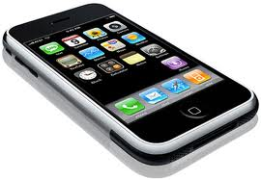
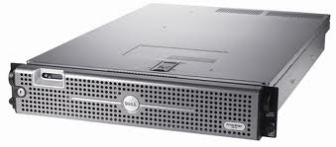
The new bytestream model
Client
ABCDEF...111232
Server
0988989 ... XYZZ
D
C
B
A
IP:2.3.4.5
IP:6.7.8.9
IP:1.2.3.4
IP:4.5.6.7
41
Notes:
arrive fort tard

Slide 42
The Multipath TCP protocol
Control plane
  How to manage a Multipath TCP connection that uses several paths ?
Data plane
  How to transport data ?
Congestion control
  How to control congestion over multiple paths ?

Slide 43
A naïve Multipath TCP
SYN+Option
SYN+ACK+Option
ACK
seq=123, "abc"
seq=126, "def"

Slide 44
A naïve Multipath TCP
In today's Internet ?
SYN+Option
SYN+ACK+Option
ACK
seq=123, "abc"
There is no
corresponding
TCP connection
seq=126, "def"

Slide 45
Design decision
  A Multipath TCP connection is composed of one of more regular TCP subflows that are combined
    Each host maintains state that glues the TCP subflows that compose a Multipath TCP connection together
    Each TCP subflow is sent over a single path and appears like a regular TCP connection along this path

Slide 46
Multipath TCP and the architecture
Application
socket
Application
Multipath TCP
Transport
TCP1
TCP2
TCPn
Network
...
Datalink
Physical
A. Ford, C. Raiciu, M. Handley, S. Barre, and J. Iyengar, “Architectural guidelines for multipath TCP development", RFC6182 2011.

Slide 47
A regular TCP connection
What is a regular TCP connection ?
  It starts with a three-way handshake
    SYN segments may contain special options
  All data segments are sent in sequence
    There is no gap in the sequence numbers
  It is terminated by using FIN or RST

Slide 48
Multipath TCP
SYN+Option
SYN+ACK+Option
ACK
SYN+OtherOption
SYN+ACK+OtherOption
ACK

Slide 49
How to combine two TCP subflows ?
SYN+Option
SYN+ACK+Option
ACK
SYN+OtherOption
How to link with
blue subflow ?
SYN+ACK+OtherOption
ACK

Slide 50
How to link TCP subflows ?
SYN, Port_{src}=1234,Port_{dst}=80+Option
SYN+ACK[...]
A NAT could change
addresses and
port numbers
ACK
SYN, Port_{src}=1235,Port_{dst}=80
+Option[link Port_{src}=1234,Port_{dst}=80]

Slide 51
How to link TCP subflows ?
SYN, Port_{src}=1234,Port_{dst}=80
+Option[Token=5678]
SYN+ACK+Option[Token=6543]
ACK
MyToken=5678
YourToken=6543
MyToken=6543
YourToken=5678
SYN, Port_{src}=1235,Port_{dst}=80
+Option[Token=6543]

Slide 52
Subflow agility
Multipath TCP supports
  addition of subflows
  removal of subflows

Slide 53
TCP subflows
Which subflows can be associated to a Multipath TCP connection ?
  At least one of the elements of the four-tuple needs to differ between two subflows
    Local IP address
    Remote IP address
    Local port
    Remote port

Slide 54
The Multipath TCP protocol
Control plane
  How to manage a Multipath TCP connection that uses several paths ?
Data plane
  How to transport data ?
Congestion control
  How to control congestion over multiple paths ?

Slide 55
How to transfer data ?
seq=123,"a"
ack=124
seq=125,"c"
ack=126
seq=124,"b"
ack=125
seq=126,"d"
ack=127

Slide 56
How to transfer data in today's Internet ?
seq=123,"a"
ack=124
seq=125,"c"
ack=126
Gap in sequence numbering space
Some DPI will not allow this !
seq=124,"b"
ack=125

Slide 57
Multipath TCP Data transfer
Two levels of sequence numbers
ABCDEF
socket
socket
Multipath TCP
Multipath TCP
Data sequence #
TCP1
TCP1 sequence #
TCP1
TCP2
TCP2 sequence #
TCP2

Slide 58
Multipath TCP
Data transfer
Dseq=0,seq=123,"a"
DAck=1,ack=124
DSeq=2, seq=124,"c"
DAck=3, ack=125
DSeq=1, seq=456,"b"
DAck=2,ack=457

Slide 59
Multipath TCP
How to deal with losses ?
Data losses over one TCP subflow
  Fast retransmit and timeout as in regular TCP
Dseq=0,seq=123,"a"
DAck=1,ack=124
Dseq=0,seq=123,"a"
DAck=1,ack=124

Slide 60
Multipath TCP
What happens when a TCP subflow fails ?
Dseq=0,seq=123,"a"
DSeq=1, seq=456,"b"
DSeq=0,ack=457
Dseq=0,seq=457,"a"
DAck=2,ack=458

Slide 61
Retransmission heuristics
Heuristics used by current Linux implementation
  Fast retransmit is performed on the same subflow
  as the original transmission
  Upon timeout expiration, reevaluate whether the segment could be retransmitted over another subflow
  Upon loss of a subflow, all the unacknowledged data are retransmitted on other subflows

Slide 62
Flow control
How should the window-based flow control be performed ?
  Independant windows on each TCP subflow
  A single window that is shared among all TCP subflows

Slide 63
Independant windows
Dseq=0,seq=123,"a"
DAck=1,ack=124,win=0
DSeq=1, seq=456,"b"
DAck=2,ack=457,win=100
Dseq=2,seq=457,"c"
DAck=3,ack=458,win=100

Slide 64
Independant windows possible problem
Dseq=0,seq=123,"a"
DSeq=1, seq=456,"b"
DAck=2,ack=457,win=0
Impossible to retransmit, window is already full on green subflow

Slide 65
A single window shared by all subflows
Dseq=0,seq=123,"a"
DAck=1,ack=124,win=10
DSeq=1, seq=456,"b"
DAck=2,ack=457,win=10
Dseq=2,seq=457,"c"
DAck=3,ack=458,win=10

Slide 66
A single window shared by all subflows
Impact of middleboxes
Dseq=0,seq=123,"a"
DAck=1,ack=124,win=100
DSeq=1, seq=456,"b"
DAck=2,ack=457,win=100
DAck=2,ack=457,win=5

Slide 67
Multipath TCP Windows
Multipath TCP maintains one window per Multipath TCP connection
  Window is relative to the last acked data (Data Ack)
  Window is shared among all subflows
    It's up to the implementation to decide how the window is shared
  Window is transmitted inside the window field of the regular TCP header
  If middleboxes change window field,
    use largest window received at MPTCP-level
    use received window over each subflow to cope with the flow control imposed by the middlebox

Slide 68
Multipath TCP buffers
MPTCP-level, resequencing possible
send(...)
recv(...)
socket
Scheduler
Multipath TCP
TCP1
TCP2
Transmit queues, process only regular TCP header
Reorder queue, processes only TCP header

Slide 69
Multipath TCP
How to exchange the Multipath TCP specific information between two hosts ?
Option 1
  Use TLVs to encode data and control information inside subflows
Option 2
  Use TCP options to encode all Multipath TCP information

Slide 70
Multipath TCP with only options
Advantages
  Normal way of extending TCP
  Should be able to go through middleboxes or fallback
Drawbacks
  limited size of the TCP options, notably inside SYN
  What happens when middleboxes drop TCP options in data segments

Slide 71
Multipath TCP using TLV
Advantages
  Multipath TCP could start as regular TCP and move to Multipath only when needed
  Could be implemented as a library in userspace
  TLVs can be easily extended
Drawbacks
  TCP segments contain TLVs including the data and not only the data
    problem for middleboxes, DPI, ..
  Middleboxes become more difficult
Michael Scharf, Thomas-Rolf Banniza , MCTCP: A Multipath Transport Shim Layer, GLOBECOM 2011

Slide 72
Multipath TCP options
TCP option format
Initial design
  One option kind for each purpose
  (e.g. Data Sequence number)
Final design
  A single variable-length Multipath TCP option
Kind
Length
Option-specific data

Slide 73
Multipath TCP option
A single option type
  to minimise the risk of having one option accepted by middleboxes in SYN segments and rejected in segments carrying data
Kind Length
Subtype
Subtype specific data
(variable length)

Slide 74
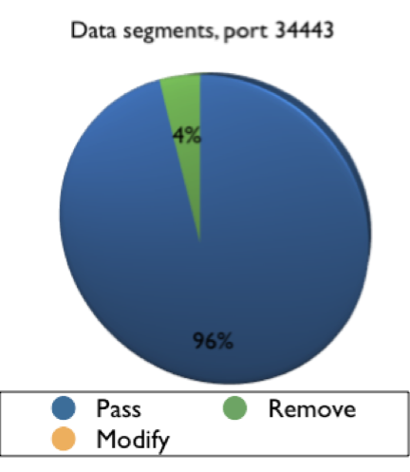
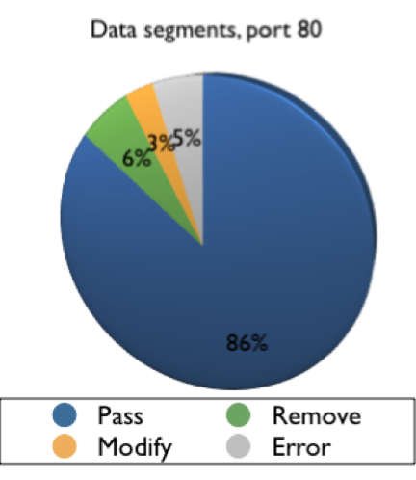
TCP options
Known option (TS) in Data segments
XD6BHM
Honda, Michio, et al. "Is it still possible to extend TCP?." Proceedings of the 2011 ACM SIGCOMM conference on Internet measurement conference. ACM, 2011.
© O. Bonaventure, 2011

Slide 75
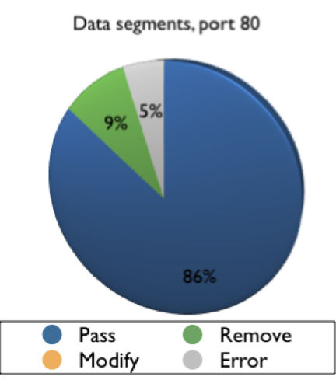
TCP options
Unknown option in Data segments
XD6BHM
Honda, Michio, et al. "Is it still possible to extend TCP?." Proceedings of the 2011 ACM SIGCOMM conference on Internet measurement conference. ACM, 2011.
© O. Bonaventure, 2011

Slide 76
Data sequence numbers and TCP segments
How to transport Data sequence numbers ?
  Same solution as for TCP
    Data sequence number in TCP option is the Data sequence number of the first byte of the segment
Source port
Destination port
Sequence number
Acknowledgment number
THL Reserved Flags
Window
Checksum
Urgent pointer
Datasequence number
Payload

Slide 77
Multipath TCP
Data transfer
Dseq=0,seq=123,"a"
DAck=1,ack=124
DSeq=2, seq=124,"c"
DAck=3, ack=125
DSeq=1, seq=456,"b"
DAck=2,ack=457

Slide 78
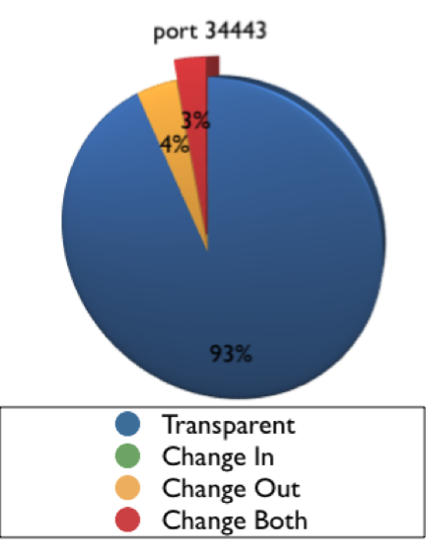
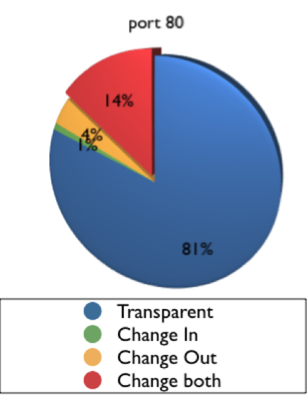
TCP sequence number and middleboxes
Honda, Michio, et al. "Is it still possible to extend TCP?." Proceedings of the 2011 ACM SIGCOMM conference on Internet measurement conference. ACM, 2011.
© O. Bonaventure, 2011

Slide 79
Which middleboxes change
TCP sequence numbers ?
Some firewalls change TCP sequence numbers in SYN segments to ensure randomness
  fix for old windows95 bug
Transparent proxies terminate TCP connections

Slide 80
Other types of middlebox interference
Data segments
Data,seq=12,"ab"
Data,seq=14,"cd"
Data,seq=12,"abcd"

Slide 81
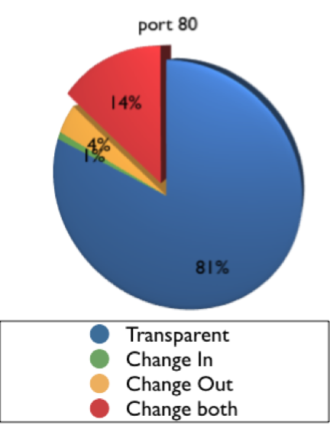
Segment coalescing
Honda, Michio, et al. "Is it still possible to extend TCP?." Proceedings of the 2011 ACM SIGCOMM conference on Internet measurement conference. ACM, 2011.
© O. Bonaventure, 2011

Slide 82
Data sequence numbers and middleboxes
buffers small
segments
seq=123,Dseq=0, "a"
seq=124, DSeq=2,"c"
seq=123, DSeq=2, "ac"
copies one option
in coalesced
segment
seq=123, DSeq=0, "ac"
seq=456, DSeq=1, "b"

Slide 83
Data sequence numbers and middleboxes
seq=123,Dseq=0, "ab"
DSeq=0, seq=123,"a"
Middlebox only
understands
regular TCP
DSeq=0, seq=124,"b"

Slide 84
Data sequence numbers and middleboxes
How to avoid desynchronisation between the bytestream and data sequence numbers ?
Solution
  Multipath TCP option carries mapping between Data sequence numbers and subflow sequence numbers
    mapping covers a part of the bytestream (length)

Slide 85
Multipath TCP
Data transfer
seq=123,DSS[0->123,len=1],"a"
DAck=1,ack=124
seq=124, DSS[2->124,len=1],"c"
DAck=3, ack=125
seq=456, DSS[1->456,len=1],"b"
DAck=2,ack=457

Slide 86
Data sequence numbers and middleboxes
seq=123,DSS[0->123,len=1], "a"
seq=124,
DSS[2->124, len=1],"c"
seq=123,
DSS[0->123, len=1],
"ac"
DAck=2,ack=124
seq=124, DSS[2->124, len=1],"c"
seq=456, DSS[1->456, len=1], "b"
DSeq=0,ack=457

Slide 87
Data sequence numbers and middleboxes
seq=123,DSS[0->123,len=1], "a"
seq=124,
DSS[2->124, len=1],"c"
seq=123,
DSS[2->124, len=1],
"ac"
DAck=0,ack=125
seq=125, DSS[0->125, len=1],"a"
DAck=3,ack=126
seq=456, DSS[1->456, len=1], "b"

Slide 88
Multipath TCP and middleboxes
With the DSS mapping, Multipath TCP can cope with middleboxes that
  combine segments
  split segments
Are they the most annoying middleboxes for Multipath TCP ?
  Unfortunately not

Slide 89
The worst middlebox
seq=123,
DSS[1->123,len=2], "ab"
seq=123,
DSS[1->123, len=2],
"aXXXb"
DAck=3,ack=125
DAck=3,ack=128
seq=125,
DSS[3->125, len=2],
"cd"
seq=128,
DSS[3->125, len=2],
"cd"
Is this an academic exercise or reality ?

Slide 90
The worst middlebox
Is unfortunately very old...
  Any ALG for a NAT
220 ProFTPD 1.3.3d Server (BELNET FTPD Server) [193.190.67.15]
ftp_login: user `<null>' pass `<null>' host `ftp.belnet.be'
Name (ftp.belnet.be:obo): anonymous
---> USER anonymous
331 Anonymous login ok, send your complete email address as your password
Password:
---> PASS XXXX
---> PORT 192,168,0,7,195,120
200 PORT command successful
---> LIST
150 Opening ASCII mode data connection for file list
lrw-r--r-- 1 ftp ftp 6 Jun 1 2011 pub -> mirror
226 Transfer complete

Slide 91
Coping with the worst middlebox
What should Multipath TCP do in the presence of such a worst middlebox ?
  Do nothing and ignore the middlebox
    but then the bytestream and the application would be broken and this problem will be difficult to debug by network administrators
  Detect the presence of the middlebox
    and fallback to regular TCP (i.e. use a single path and nothing fancy)

Slide 92
Detecting the worst middlebox ?
How can Multipath TCP detect a middlebox that modifies the bytestream and inserts/removes bytes ?
  Various options were explored
  In the end, Multipath TCP chose to include its own checksum to detect insertion/deletion of bytes

Slide 93
The worst middlebox
seq=123,
DSS[1->123,len=2,V], "ab"
seq=123,
DSS[1->123, len=2,Inv],
"aXXXb"
RST, last DSeq=0
RST, last DSeq=0
seq=456, DSS[1->456, len=2,V], "ab"
DAck=3,ack=458

Slide 94
Multipath TCP
Data sequence numbers
What should be the length of the data sequence numbers ?
  32 bits
    compact and compatible with TCP
    wrap around problem at highspeed requires PAWS
  64 bits
    wrap around is not an issue for most transfers today
    takes more space inside each segment

Slide 95
Multipath TCP
Data sequence numbers
Data sequence numbers and Data acknowledgements
  Maintained as 64 bits field
  Implementations can, as an optimisation, only transmit the lower 32 bits of the data sequence and acknowledgements

Slide 96
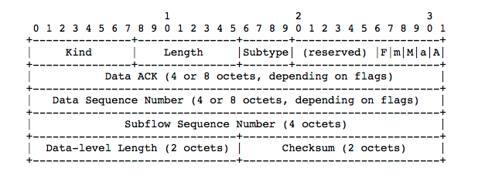
Data Sequence Signal option
A = Data ACK present
a = Data ACK is 8 octets
M = mapping present
m = DSN is 8
Cumulative Data ack
Length of mapping, can extend
beyond this segment
Computed over data covered by
entire mapping + pseudo header

Slide 97
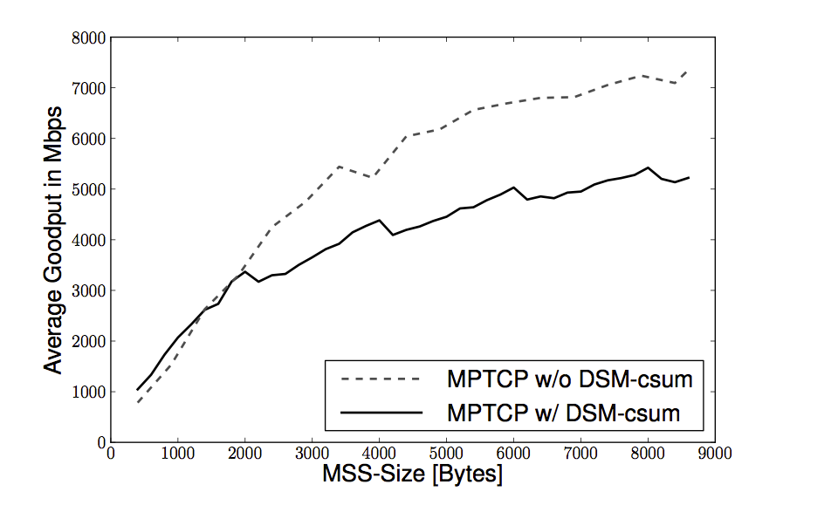
Cost of the DSN checksum
C. Raiciu, et al. “How hard can it be? designing and implementing a deployable multipath TCP,” NSDI'12: Proceedings of the 9th USENIX conference on Networked Systems Design and Implementation, 2012.

Slide 98
The Multipath TCP protocol
Control plane
  How to manage a Multipath TCP connection that uses several paths ?
Data plane
  How to transport data ?
Congestion control
  How to control congestion over multiple paths ?

Slide 99

TCP congestion control
A linear rate adaption algorithm
To be fair and efficient, a linear algorithm must use additive increase and multiplicative decrease (AIMD)
# Additive Increase Multiplicative Decrease
if congestion :
rate=rate*betaC # multiplicative decrease, betaC<1
else
rate=rate+alphaN # additive increase, v0>0
CNP3/2010.3.
© O. Bonaventure, 2008

Slide 100
AIMD in TCP
Congestion control mechanism
  Each host maintains a congestion window (cwnd)
  No congestion
    Congestion avoidance (additive increase)
      increase cwnd by one segment every round-trip-time
  Congestion
    TCP detects congestion by detecting losses
    Mild congestion (fast retransmit – multiplicative decrease)
      cwnd=cwnd/2 and restart congestion avoidance
    Severe congestion (timeout)
      cwnd=1, set slow-start-threshold and restart slow-start

Slide 101
Evolution of the congestion window
Cwnd
Fast retransmit
Fast retransmit
Threshold
Threshold
Slow-start
exponential increase of cwnd
Congestion avoidance
linear increase of cwnd
Time

Slide 102
Congestion control for Multipath TCP
Simple approach
  independant congestion windows
Threshold
Threshold
Threshold

Slide 103
Independant congestion windows
Problem
12Mbps

Slide 104
Coupling the congestion windows
Principle
  The TCP subflows are not independant and their congestion windows must be coupled
EWTCP
  For each ACK on path r, cwin_{r}=cwin_{r}+a/cwin_{r} (in segments)
  For each loss on path r, cwin_{r}=cwin_{r}/2
  Each subflow gets window size proportional to a²
  Same throughput as TCP if
M. Honda, Y. Nishida, L. Eggert, P. Sarolahti, and H. Tokuda. Multipath Congestion Control for Shared Bottleneck. In Proc. PFLDNeT workshop, May 2009.

Slide 105
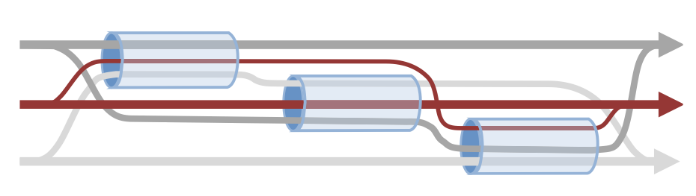
Can we split traffic equally among all subflows ?
12Mbps
12Mbps
12Mbps
In this scenario, EWTCP would get 3.5 Mbps on the two
hops path and 5 Mbps on the one hop path, less than
the optimum of 12 Mbps for each Multipath TCP connection
D. Wischik, C. Raiciu, A. Greenhalgh, and M. Handley, “Design, implementation and evaluation of congestion control for multipath TCP,” NSDI'11: Proceedings of the 8th USENIX conference on Networked systems design and implementation, 2011.

Slide 106
Linked increases congestion control
Algorithm
  For each loss on path r, cwin_{r}=cwin_{r}/2
  Additive increase
D. Wischik, C. Raiciu, A. Greenhalgh, and M. Handley, “Design, implementation and evaluation of congestion control for multipath TCP,” NSDI'11: Proceedings of the 8th USENIX conference on Networked systems design and implementation, 2011.

Slide 107
Other Multipath-aware congestion control schemes
R. Khalili, N. Gast, M. Popovic, U. Upadhyay, J.-Y. Le Boudec , MPTCP is not Pareto-optimal: Performance issues and a possible solution, Proc. ACM Conext 2012
Y. Cao, X. Mingwei, and X. Fu, “Delay-based Congestion Control for Multipath TCP,” ICNP2012, 2012.
T. A. Le, C. S. Hong, and E.-N. Huh, “Coordinated TCP Westwood congestion control for multiple paths over wireless networks,” ICOIN '12: Proceedings of the The International Conference on Information Network 2012, 2012, pp. 92–96.
T. A. Le, H. Rim, and C. S. Hong, “A Multipath Cubic TCP Congestion Control with Multipath Fast Recovery over High Bandwidth-Delay Product Networks,” IEICE Transactions, 2012.
T. Dreibholz, M. Becke, J. Pulinthanath, and E. P. Rathgeb, “Applying TCP-Friendly Congestion Control to Concurrent Multipath Transfer,” Advanced Information Networking and Applications (AINA), 2010 24th IEEE International Conference on, 2010, pp. 312–319.

Slide 108
The Multipath TCP protocol
Control plane
  How to manage a Multipath TCP connection that uses several paths ?
Data plane
  How to transport data ?
Congestion control
  How to control congestion over multiple paths ?

Slide 109
The Multipath TCP control plane
Connection establishment in details
Closing a Multipath TCP connection
Address dynamics

Slide 110
Security threats
Three main security threats were considered
  flooding attack
  man-in-the middle attack
  hijacking attach
Security goal :
Multipath TCP should not be
worse than regular TCP
J. Diez, M. Bagnulo, F. Valera, and I. Vidal, “Security for multipath TCP: a constructive approach,” International Journal of Internet Protocol Technology, vol. 6, 2011.

Slide 111
Hijacking attack

Slide 112
Multipath TCP
Connection establishment
Principle
SYN, MP_CAPABLE
SYN+ACK, MP_CAPABLE
ACK, MP_CAPABLE
seq=123, DSeq=1, "abc"

Slide 113
Roles of the initial TCP handshake
Check willingness to open TCP connection
  Propose initial sequence number
  Negotiate Maximum Segment Size
TCP options
  negotiate Timestamps, SACK, Window scale
Multipath TCP
  check that server supports Multipath TCP
  propose Token in each direction
  propose initial Data sequence number in each direction
  Exchange keys to authenticate subflows

Slide 114
How to extend TCP ?
Theory
TCP options were invented for this purpose
  Exemple SACK
SACK enabled
SYN+SACK Permitted
SYN+ACK SACK Permitted
SACK ?
SACK yes

Slide 115
How to extend TCP ? practice
What happens when there are middleboxes on the path ?
SYN+SACK Permitted
SACK
no
SYN
SYN+ACK
SYN+ACK
SACK
no

Slide 116

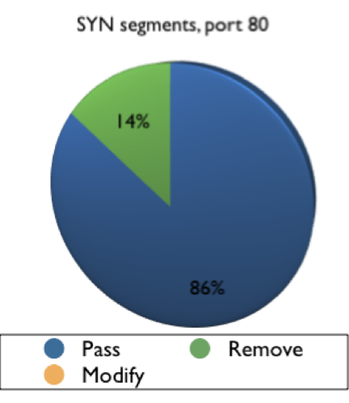
TCP options
In SYN segments
XD6BHM
Honda, Michio, et al. "Is it still possible to extend TCP?." Proceedings of the 2011 ACM SIGCOMM conference on Internet measurement conference. ACM, 2011.
© O. Bonaventure, 2011

Slide 117
How to extend TCP ?
The worst case
What happens when there are middleboxes on the path ?
SYN+SACK Permitted
SYN+SACK Permitted
SYN+ACK
SACK
enabled
SACK
no
SYN+ACK SACK Permitted
Client and server do not agree
on TCP extension !!!

Slide 118
Multipath TCP handshake
Does server support Multipath TCP ?
SYN, MP_CAPABLE[...]
SYN+ACK, MP_CAPABLE[...]
ACK+MPTCPOption
Why an option in
third ACK ?

Slide 119
Multipath TCP option in third ACK
SYN, MP_CAPABLE[...]
SYN+ACK, MP_CAPABLE[...]
SYN+ACK
ACK
No option, disable
Multipath TCP

Slide 120
Multipath TCP handshake
Token exchange
SYN, MP_CAPABLE[ClientToken=1234]
SYN+ACK, MP_CAPABLE[ServerToken=5678]
ACK, MP_CAPABLE[ClientToken=1234]
Useful if server wants to send SYN+ACK without keeping any state

Slide 121
Initial Data Sequence number
Why do we need an initial Data Sequence number ?
  Setting IDSN to a random value improves security
  Hosts must know IDSN to avoid losing data in some special cases

Slide 122
Initial Data Sequence number
SYN, MP_CAPABLE
SYN+ACK, MP_CAPABLE
ACK
seq=123,
DSS[456->123,len=2],"ab"
First Data or not ?
SYN...
SYN+ACK...
ACK
seq=789, DSS[458->789, len=2], "cd"
Notes:
attaquant pourrait injecter le numéro de séquence initial et le choisir

Slide 123
Initial Data Sequence number
How to fix the IDSN ?
SYN, MP_CAPABLE[DSeq=23456]
SYN+ACK, MP_CAPABLE[DSeq=67890]
ACK

Slide 124
How to secure Multipath TCP
Main goal
  Authenticate the establishment of subflows
Principles
  Each host announces a key during initial handshake
    keys are exchanged in clear
  When establishing a subflow, use HMAC + key to authenticate subflow

Slide 125
Key exchange
SYN, [MyKey="keyABC"]
SYN+ACK, [MyKey="keyDEF"]
ACK[MyKey="keyABC", YourKey="keyDEF"]
MyKey="keyABC"
MyKey="keyDEF"
YourKey="keyDEF"
YourKey="keyABC"
SYN,[NonceA=123]
SYN+ACK[NonceB=456,
HMAC(123,"keyDEF")]
ACK,[HMAC(456,"keyABC")]

Slide 126
Putting everything inside the SYN
How can we place inside the SYN segment
  Initial Data Sequence Number (64 bits)
  Token (32 bits)
  Authentication Key (the longer the better)

Slide 127
Constraint on TCP options
Ver IHL ToS
Total length
Total length of TCP header : max 64 bytes
  max 44 bytes for TCP options
  size must be multiple of 4 bytes
Identification
Flags Frag. Offset
TTL Protocol
Checksum
Source IP address
Destination IP address
Source port
Destination port
Sequence number
Acknowledgment number
THL Reserved Flags
Window
Checksum
Urgent pointer
Options
Payload

Slide 128
TCP options in the wild
MSS option [4 bytes]
  Used only inside SYN segments
Timestamp option [10 bytes]
  Used in potentially all segments
Window scale option [3 bytes]
  Used only inside SYN segments
SACK permitted option [2 bytes]
  Used only inside SYN segments
Selective Acknowledgements [N bytes]
  Used in data segments
Only 20 bytes left
inside SYN !
http://www.iana.org/assignments/tcp-parameters/tcp-parameters.xml

Slide 129
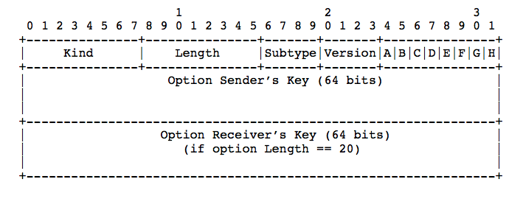
The MP_CAPABLE option
crypto
A: DSN Checksum
required or not
B: Extension
Used inside SYN
Only in third ACK

Slide 130
Initial Data Sequence Numbers and Tokens
Where is the initial Data Sequence Number
Where is the token ?
IDSN_{A}=Lower₆₄(SHA-1(Key_{A}))
IDSN_{B}=Lower₆₄(SHA-1(Key_{B}))
There is a small
risk of collision,
different keys
same token
Token_{A}=Upper₃₂(SHA-1(Key_{A}))
Token_{B}=Upper₃₂(SHA-1(Key_{B}))

Slide 131
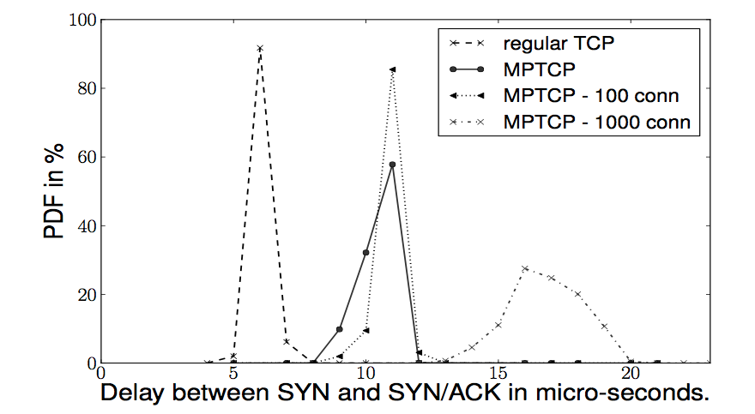
Cost of the Multipath TCP handshake
C. Raiciu, et al. “How hard can it be? designing and implementing a deployable multipath TCP,” NSDI'12: Proceedings of the 9th USENIX conference on Networked Systems Design and Implementation, 2012.

Slide 132
The Multipath TCP control plane
Connection establishment in details
Closing a Multipath TCP connection
Address dynamics

Slide 133
Closing a Multipath TCP connection
How to close a Multipath TCP connection ?
  By closing all subflows ?
RST
RST

Slide 134
Closing a Multipath TCP connection
seq=123, DSS[1->123 ...], "ab"
seq=125, DSS[5->125,DATA_FIN ...], "end"
DAck=9,ack=128
seq=128, FIN
ack=129
seq=456, DSS[3->456], "cd"
DAck=5,ack=458

Slide 135
Closing a Multipath TCP connection
FAST Close
SYN, [...]
SYN+ACK, [...]
ACK[...]
ACK+FAST_CLOSE
RST
SYN,[...]
SYN+ACK[...]
ACK[..]
RST

Slide 136
The Multipath TCP control plane
Connection establishment in details
Closing a Multipath TCP connection
Address dynamics

Slide 137
Multipath TCP
Address dynamics
How to learn the addresses of a host ?
How to deal with address changes
IP=2.3.4.5
IP=3.4.5.6
IP6=2a00:1450:400c:c05::69
IP=1.2.3.4
IP=4.5.6.7

Slide 138
Address dynamics
Basic solution : multihomed server
SYN, [...]
SYN+ACK, [...]
ACK[...]
ADD_ADDR[3.4.5.6]
IP=2.3.4.5
IP=3.4.5.6
IP6=2a00:1450:400c:c05::69
ADD_ADDR[2a00:1450:400c:c05::69]
SYN,[...]
SYN+ACK[...]
ACK[..]

Slide 139
Address dynamics
Basic solution : mobile client
SYN, [...]
SYN+ACK, [...]
ACK[...]
ADD_ADDR [4.5.6.7]
IP=2.3.4.5
SYN,[...]
IP=1.2.3.4
SYN+ACK[...]
IP=4.5.6.7
ACK[..]
REMOVE_ADDR[1.2.3.4]

Slide 140
Address dynamics in today's Internet
SYN, [...]
SYN+ACK, [...]
ACK[...]
ADD_ADDR [10.0.0.2]
ADD_ADDR [10.0.0.2]
IP=2.3.4.5
IP=1.2.3.4
?
SYN [...]
IP=10.0.02

Slide 141
Address dynamics with NATs
Solution
  Each address has one identifier
    Subflow is established between id=0 addresses
  Each host maintains a list of <address,id> pairs of the addresses associated to an MPTCP endpoint
  MPTCP options refer to the address identifier
    ADD_ADDR contains <address,id>
    REMOVE_ADDR contains <id>

Slide 142
Address dynamics
SYN, [...]
SYN+ACK, [...]
ACK[...]
ADD_ADDR [4.5.6.7,id=1]
IP=2.3.4.5
SYN,[id=1...]
IP=1.2.3.4
SYN+ACK[...]
IP=4.5.6.7
ACK[..]
REMOVE_ADDR[id=0]

Slide 143
Agenda
The motivations for Multipath TCP
The changing Internet
The Multipath TCP Protocol
Multipath TCP use cases
  Datacenters
  Smartphones

Slide 144
Datacenters evolve
Traditional Topologies are tree-based
  Poor performance
  Not fault tolerant
Shift towards multipath topologies: FatTree, BCube, VL2,
Cisco, EC2
…
C. Raiciu, et al. “Improving datacenter performance and robustness with multipath TCP,” ACM SIGCOMM 2011.

Slide 145
Fat Tree Topology [Fares et al., 2008; Clos, 1953]
K=4
Aggregation Switches
1Gbps
K Pods with
K Switches
each
1Gbps
Racks of
servers
Notes:
Show multiple paths between servers
Say that network is rearrangeably non blocking
Clos
145

Slide 146
Fat Tree Topology [Fares et al., 2008; Clos, 1953]
K=4
Aggregation Switches
K Pods with
K Switches
each
Racks of
servers
C. Raiciu, et al. “Improving datacenter performance and robustness with multipath TCP,” ACM SIGCOMM 2011.
Notes:
Show multiple paths between servers
Say that network is rearrangeably non blocking
Clos
146

Slide 147
Collisions
Notes:
Show multiple paths between servers
Say that network is rearrangeably non blocking
Clos
147

Slide 148
TCP in data centers

Slide 149
TCP in FAT tree networks
Cost of collissions
C. Raiciu, et al. “Improving datacenter performance and robustness with multipath TCP,” ACM SIGCOMM 2011.

Slide 150

How to get rid of these collisions ?
Consider TCP performance as an optimisation problem

Slide 151
The Multipath TCP way
ECMP balances
the subflows
over different
paths
Two subflows
differ by their
source port
C. Raiciu, et al. “Improving datacenter performance and robustness with multipath TCP,” ACM SIGCOMM 2011.

Slide 152
MPTCP better utilizes the FatTree network
C. Raiciu, et al. “Improving datacenter performance and robustness with multipath TCP,” ACM SIGCOMM 2011.
Notes:
Fairness matters for apps!

Slide 153
How many subflows does Multipath TCP need ?
Total Throughput
TCP
C. Raiciu, et al. “Improving datacenter performance and robustness with multipath TCP,” ACM SIGCOMM 2011.

Slide 154
Can we improve Multipath TCP ?
Two subflows may follow similar paths

Slide 155
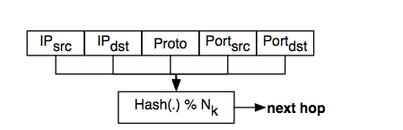
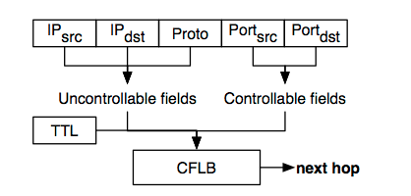
Improving ECMP
ECMP's hash
  good load balancing
  impossible to predict result
CFLB
  replaces hash with
  block cipher
  hosts can select paths
  for Multipath TCP subflows
  provided they know datacenter topology
G. Detal, Ch. Paasch, S. van der Linden, P. Mérindol, G. Avoine, O. Bonaventure, Revisiting Flow-Based Load Balancing: Stateless Path Selection in Data Center Networks, to appear in Computer Networks

Slide 156
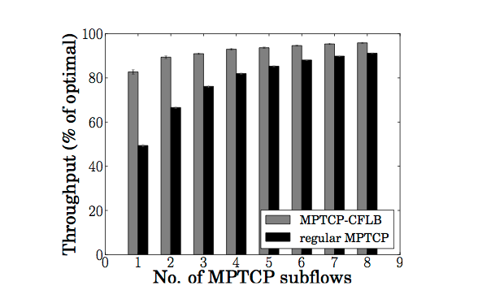
Multipath TCP with CFLB in Fat-Tree
G. Detal, Ch. Paasch, S. van der Linden, P. Mérindol, G. Avoine, O. Bonaventure, Revisiting Flow-Based Load Balancing: Stateless Path Selection in Data Center Networks, to appear in Computer Networks

Slide 157
Multipath TCP on EC2
Amazon EC2: infrastructure as a service
  We can borrow virtual machines by the hour
  These run in Amazon data centers worldwide
  We can boot our own kernel
A few availability zones have multipath topologies
  2-8 paths available between hosts not on the same machine or in the same rack
  Available via ECMP

Slide 158
Amazon EC2 Experiment
40 medium CPU instances running MPTCP
During 12 hours, we sequentially ran all-to-all iperf cycling through:
  TCP
  MPTCP (2 and 4 subflows)

Slide 159
MPTCP improves performance on EC2
Same
Rack
C. Raiciu, et al. “Improving datacenter performance and robustness with multipath TCP,” ACM SIGCOMM 2011.

Slide 160
Agenda
The motivations for Multipath TCP
The changing Internet
The Multipath TCP Protocol
Multipath TCP use cases
  Datacenters
  Smartphones

Slide 161




Motivation
One device, many IP-enabled interfaces

Slide 162
MPTCP over WiFi/3G
8Mbps, 20ms
2Mbps, 150ms

Slide 163
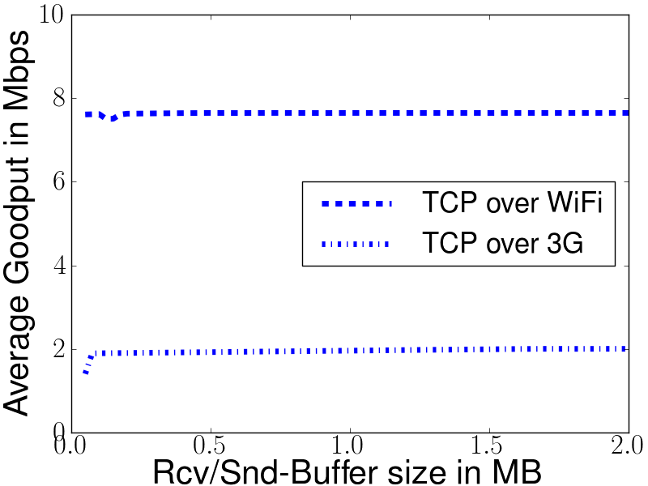
TCP over WiFi/3G
C. Raiciu, et al. “How hard can it be? designing and implementing a deployable multipath TCP,” NSDI'12: Proceedings of the 9th USENIX conference on Networked Systems Design and Implementation, 2012.

Slide 164
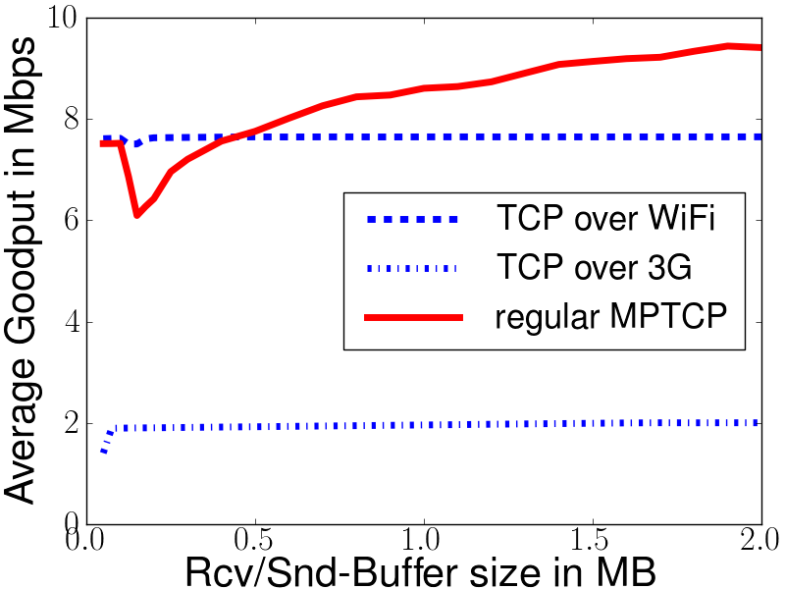
MPTCP over WiFi/3G
C. Raiciu, et al. “How hard can it be? designing and implementing a deployable multipath TCP,” NSDI'12: Proceedings of the 9th USENIX conference on Networked Systems Design and Implementation, 2012.

Slide 165
MPTCP over WiFi/3G
Multipath TCP
increases
throughput

Slide 166
MPTCP over WiFi/3G
What happened here?

Slide 167
Understanding the performance issue
Window full !
No new data can be sent on WiFi path
D
C
B
8Mbps, 20ms
A
2Mbps, 150ms
Window
A
Reinject segment on fast path
Halve congestion window on slow subflow

Slide 168
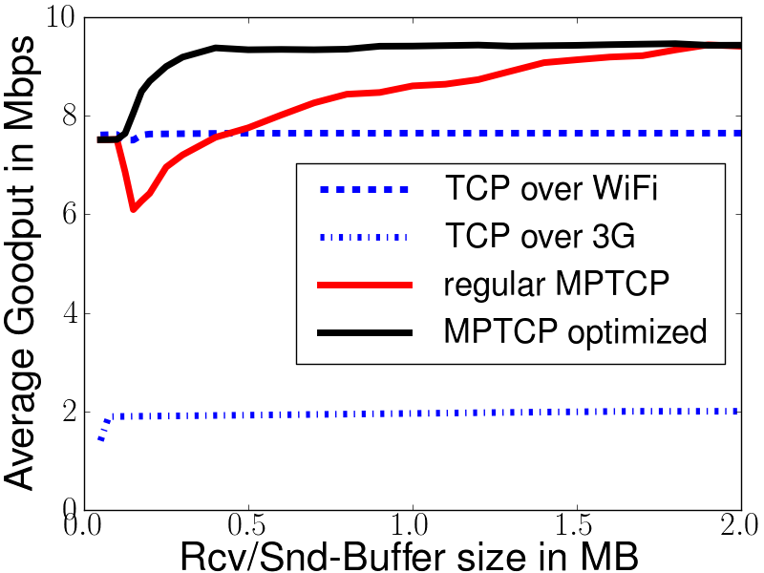
MPTCP over WiFi/3G

Slide 169
Usage of 3G and WiFI
How should Multipath TCP use 3G and WiFi ?
  Full mode
    Both wireless networks are used at the same time
  Backup mode
    Prefer WiFi when available, open subflows on 3G and use them as backup
  Single path mode
    Only one path is used at a time, WiFi preferred over 3G

Slide 170
Multipath TCP : Full mode
SYN...
SYN+ACK...
ACK...
WiFi
3G/LTE
SYN...
SYN+ACK,...
ACK ...

Slide 171
Multipath TCP : Backup mode
SYN...
SYN+ACK...
ACK...
WiFi
3G/LTE
SYN,MP_JOIN[Backup...]
Dynamically
change backup
status of flow
SYN+ACK,...
ACK ...
MP_PRIO[B]

Slide 172
Multipath TCP : Backup mode
What happens when link fails ?
SYN...
SYN+ACK...
ACK...
WiFi
3G/LTE
SYN,MP_JOIN[Backup...]
SYN+ACK,...
ACK ...
REM_ADDR[id=0]

Slide 173
Multipath TCP : single-path mode
Multipath TCP supports break before make
SYN...
SYN+ACK...
ACK...
WiFi
3G/LTE
SYN,MP_JOIN
SYN+ACK,...
ACK ...
REM_ADDR[id=0]

Slide 174
Evaluation scenario
WiFi:
Belgacom ADSL2+
(~8 Mbps, ~30 ms)
3G: Mobistar
(~2 Mbps, ~80ms)

Slide 175
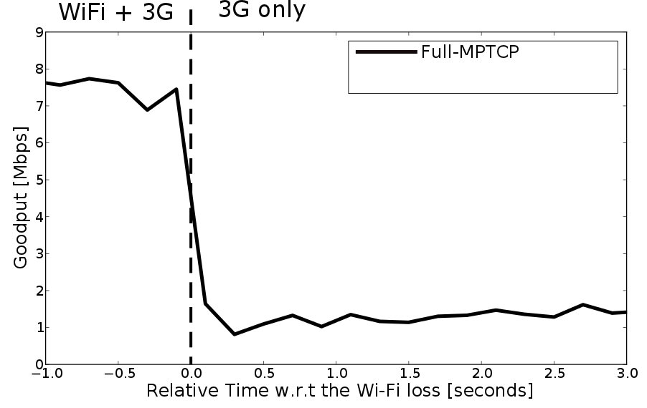
Recovery after failure
C. Paasch, et al. , “Exploring mobile/WiFi handover with multipath TCP,” presented at the CellNet '12: Proceedings of the 2012 ACM SIGCOMM workshop on Cellular networks: operations, challenges, and future design, 2012.

Slide 176
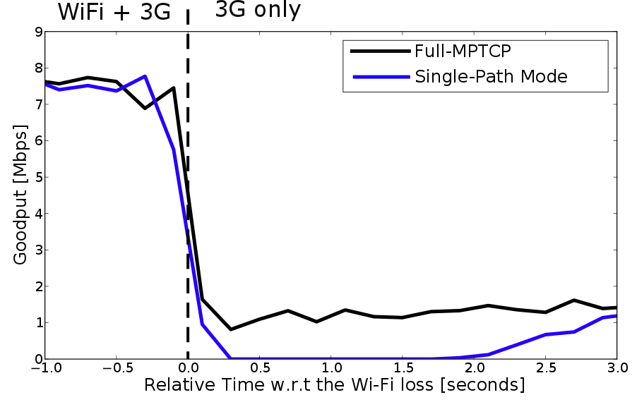
Recovery after failure
C. Paasch, et al. , “Exploring mobile/WiFi handover with multipath TCP,” presented at the CellNet '12: Proceedings of the 2012 ACM SIGCOMM workshop on Cellular networks: operations, challenges, and future design, 2012.

Slide 177
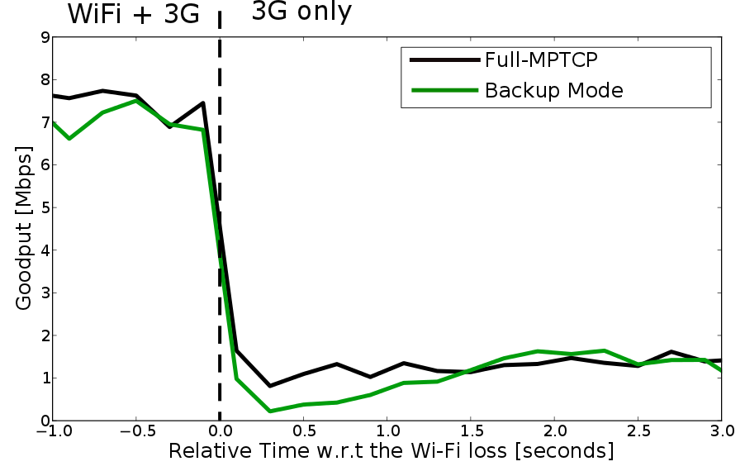
Recovery after failure
C. Paasch, et al. , “Exploring mobile/WiFi handover with multipath TCP,” presented at the CellNet '12: Proceedings of the 2012 ACM SIGCOMM workshop on Cellular networks: operations, challenges, and future design, 2012.

Slide 178



Conclusion
Multipath TCP is becoming a reality
  Due to the middleboxes, the protocol is more complex than initially expected
  RFC will appear and there is running code !
  Multipath TCP works over today's Internet !
What's next ?
  More use cases
    IPv4/IPv6, anycast, load balancing, deployment
  Measurements and improvements to the protocol
    Time to revisit 20+ years of heuristics added to TCP

Slide 179
References
The Multipath TCP protocol
  http://www.multipath-tcp.org
  http://tools.ietf.org/wg/mptcp/
A. Ford, C. Raiciu, M. Handley, S. Barre, and J. Iyengar, “Architectural guidelines for multipath TCP development", RFC6182 2011.
A. Ford, C. Raiciu, M. J. Handley, and O. Bonaventure, “TCP Extensions for Multipath Operation with Multiple Addresses,” Internet draft, draft-ietf-mptcp-multiaddressed-12, 2012
C. Raiciu, C. Paasch, S. Barre, A. Ford, M. Honda, F. Duchene, O. Bonaventure, and M. Handley, “How hard can it be? designing and implementing a deployable multipath TCP,” NSDI'12: Proceedings of the 9th USENIX conference on Networked Systems Design and Implementation, 2012.

Slide 180
Implementations
Linux
  http://www.multipath-tcp.org
FreeBSD
  http://caia.swin.edu.au/urp/newtcp/mptcp/
Simulators
  http://nrg.cs.ucl.ac.uk/mptcp/implementation.html
  http://code.google.com/p/mptcp-ns3/
S. Barre, C. Paasch, and O. Bonaventure, “Multipath tcp: From theory to practice,” NETWORKING 2011, 2011.
Sébastien Barré. Implementation and assessment of Modern Host-based Multipath Solutions. PhD thesis. UCL, 2011

Slide 181
Middleboxes
M. Honda, Y. Nishida, C. Raiciu, A. Greenhalgh, M. Handley, and H. Tokuda, “Is it still possible to extend TCP?,” IMC '11: Proceedings of the 2011 ACM SIGCOMM conference on Internet measurement conference, 2011.
V. Sekar, N. Egi, S. Ratnasamy, M. K. Reiter, and G. Shi, “Design and implementation of a consolidated middlebox architecture,” USENIX NSDI, 2012.
J. Sherry, S. Hasan, C. Scott, A. Krishnamurthy, S. Ratnasamy, and V. Sekar, “Making middleboxes someone else's problem: network processing as a cloud service,” SIGCOMM '12: Proceedings of the ACM SIGCOMM 2012 conference on Applications, technologies, architectures, and protocols for computer communication, 2012.

Slide 182
Multipath congestion control
  Background
  Coupled congestion control
D. Wischik, M. Handley, and M. B. Braun, “The resource pooling principle,” ACM SIGCOMM Computer …, vol. 38, no. 5, 2008.
F. Kelly and T. Voice. Stability of end-to-end algorithms for joint routing and rate control. ACM SIGCOMM CCR, 35, 2005.
P. Key, L. Massoulie, and P. D. Towsley, “Path Selection and Multipath Congestion Control,” INFOCOM 2007. 2007, pp. 143–151.
C. Raiciu, M. J. Handley, and D. Wischik, “Coupled Congestion Control for Multipath Transport Protocols,” RFC, vol. 6356, Oct. 2011.
D. Wischik, C. Raiciu, A. Greenhalgh, and M. Handley, “Design, implementation and evaluation of congestion control for multipath TCP,” NSDI'11: Proceedings of the 8th USENIX conference on Networked systems design and implementation, 2011.

Slide 183
Multipath congestion control
  More
R. Khalili, N. Gast, M. Popovic, U. Upadhyay, J.-Y. Le Boudec , MPTCP is not Pareto-optimal: Performance issues and a possible solution, Proc. ACM Conext 2012
Y. Cao, X. Mingwei, and X. Fu, “Delay-based Congestion Control for Multipath TCP,” ICNP2012, 2012.
T. A. Le, C. S. Hong, and E.-N. Huh, “Coordinated TCP Westwood congestion control for multiple paths over wireless networks,” ICOIN '12: Proceedings of the The International Conference on Information Network 2012, 2012, pp. 92–96.
T. A. Le, H. Rim, and C. S. Hong, “A Multipath Cubic TCP Congestion Control with Multipath Fast Recovery over High Bandwidth-Delay Product Networks,” IEICE Transactions, 2012.
T. Dreibholz, M. Becke, J. Pulinthanath, and E. P. Rathgeb, “Applying TCP-Friendly Congestion Control to Concurrent Multipath Transfer,” Advanced Information Networking and Applications (AINA), 2010 24th IEEE International Conference on, 2010, pp. 312–319.

Slide 184
Use cases
  Datacenter
  Mobile
C. Raiciu, S. Barre, C. Pluntke, A. Greenhalgh, D. Wischik, and M. J. Handley, “Improving datacenter performance and robustness with multipath TCP,” ACM SIGCOMM 2011.
G. Detal, Ch. Paasch, S. van der Linden, P. Mérindol, G. Avoine, O. Bonaventure, Revisiting Flow-Based Load Balancing: Stateless Path Selection in Data Center Networks, to appear in Computer Networks
C. Pluntke, L. Eggert, and N. Kiukkonen, “Saving mobile device energy with multipath TCP,” MobiArch '11: Proceedings of the sixth international workshop on MobiArch, 2011.
C. Paasch, G. Detal, F. Duchene, C. Raiciu, and O. Bonaventure, “Exploring mobile/WiFi handover with multipath TCP,” CellNet '12: Proceedings of the 2012 ACM SIGCOMM workshop on Cellular networks: operations, challenges, and future design, 2012.

